Slide 1
Compiler course
Chapter 7
Run-Time Environments

Slide 2
Contents
Symbol table entries and operations
Storage organization
Stack allocation of Space
Access to Nonlocal Data on the Stack
Heap Management

Slide 3
Symbol table entries and operations
Symbol table is created during the lexical analysis phase
and is maintained till the last phase is competed.
Symbol table is an important data structure which
stores the information of all the variables and procedures in
the program.
Organizing the elements in the symbol table shows the
impact on the performance of the compiler.

Slide 4
Symbol table operations
Insert
Look-up
Different mechanism in organizing elements of S.T
Linear list
Heirarchical list
Hashing Scheme (better performance)

Slide 5
Name | type | size | Dim | Line of declaration | Line of usage | Address
Name | Char | 20 | 1 | 10 | 20
Age | Int | 1 | 0 | 8 | 21
Address | Char | 30 | 1 | 12 | 22
Phone no. | int | 20 | 1 | 13 | 33
Name |  | type | size | Dim | Line of declaration | Line of usage | Address
0 | 4 | Char | 20 | 1 | 10 | 20
5 | 3 | Int | 1 | 0 | 8 | 21
9 | 8 | Char | 30 | 1 | 12 | 22
17 | 7 | int | 20 | 1 | 13 | 33

Slide 6
Symbol table entries
Name
Size
Dimension
Type
Line of Declaration
Line of usage
Address

Slide 7
Symbol table operations
For non block structure languages the operations are
1.Insert
2.Lookup
For block structure languages the operations are
1.Insert
2.Lookup
3.Set
4.Reset

Slide 8
Run Time environment
Storage Allocation Strategies:
Compiler must do the storage allocation and provide access to variables and data
Memory management
  Stack allocation
  Heap management

Slide 9
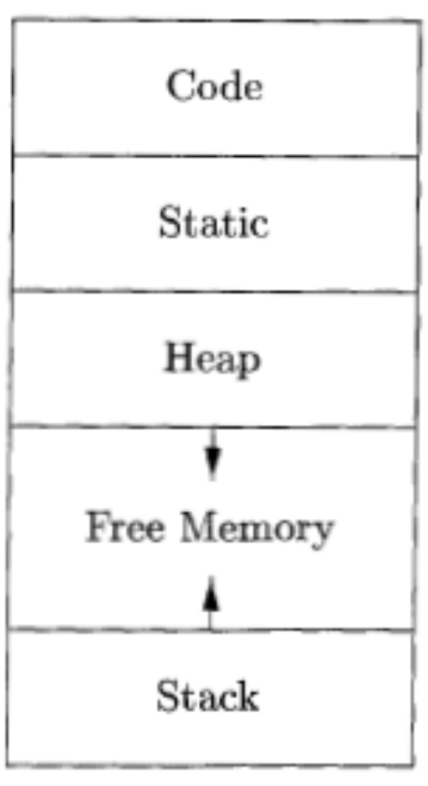
Storage Organization

Slide 10
Static vs. Dynamic Allocation
Static: Compile time,
Dynamic: Runtime allocation
Many compilers use some combination of following
  Stack storage: for local variables, parameters and so on
  Heap storage: Data that may outlive the call to the procedure that created it
Stack allocation is a valid allocation for procedures since procedure calls are nested

Slide 11
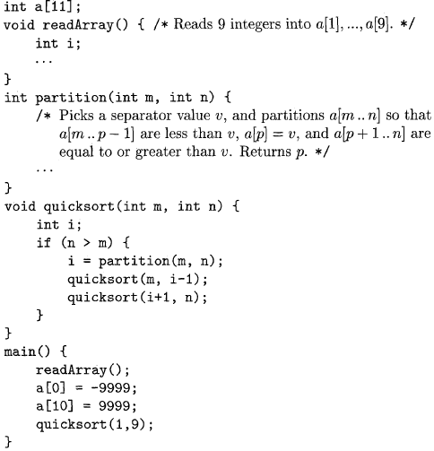
Sketch of a quicksort program

Slide 12
Procedure Activation and Lifetime
A procedure is activated when called
The lifetime of an activation of a procedure is the sequence of steps between the first and last steps in the execution of the procedure body
A procedure is recursive if a new activation can begin before an earlier activation of the same procedure has ended

Slide 13
Procedure Activations: Example
program sort(input, output)
var a : array [0..10] of integer;
procedure readarray;
var i : integer;
begin
for i := 1 to 9 do read(a[i])
end;
function partition(y, z : integer) : integer
var i, j, x, v : integer;
begin …
end
procedure quicksort(m, n : integer);
var i : integer;
begin
if (n > m) then begin
i := partition(m, n);
quicksort(m, i - 1);
quicksort(i + 1, n)
end
end;
begin
a[0] := -9999; a[10] := 9999;
readarray;
quicksort(1, 9)
end.
Activations:
begin sort
enter readarray
leave readarray
enter quicksort(1,9)
enter partition(1,9)
leave partition(1,9)
enter quicksort(1,3)
…
leave quicksort(1,3)
enter quicksort(5,9)
…
leave quicksort(5,9)
leave quicksort(1,9)
end sort.

Slide 14
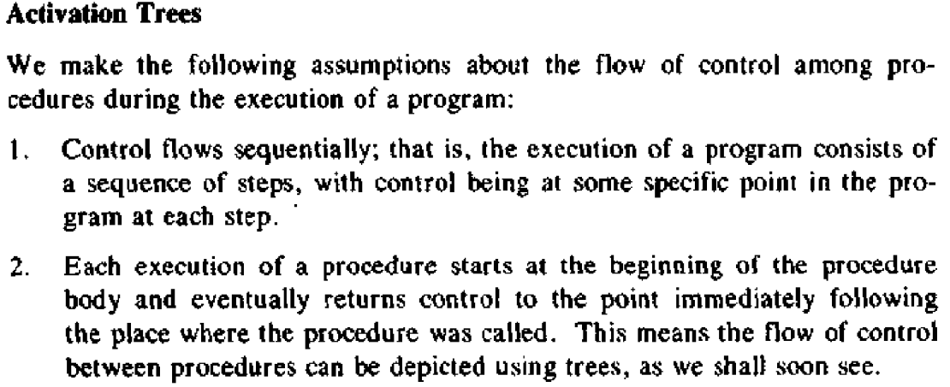

Slide 15
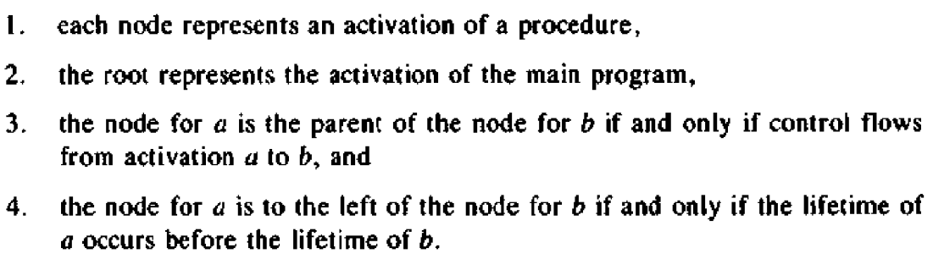

Slide 16
Activation Trees: Example
s
r
q(1,9)
p(1,9)
q(1,3)
q(5,9)
p(1,3)
q(1,0)
q(2,3)
p(5,9)
q(5,5)
q(7,9)
p(2,3)
q(2,1)
q(3,3)
p(7,9)
q(7,7)
q(9,9)
Activation tree for the sort program
Note: also referred to as the dynamic call graph

Slide 17
Control Stack
Activation tree:
Control
stack:
Activations:
begin sort
enter readarray
leave readarray
enter quicksort(1,9)
enter partition(1,9)
leave partition(1,9)
enter quicksort(1,3)
enter partition(1,3)
leave partition(1,3)
enter quicksort(1,0)
leave quicksort(1,0)
enter quicksort(2,3)
…
s
s
q(1,9)
q(1,3)
q(2,3)
r
q(1,9)
p(1,9)
q(1,3)
p(1,3)
q(1,0)
q(2,3)

Slide 18
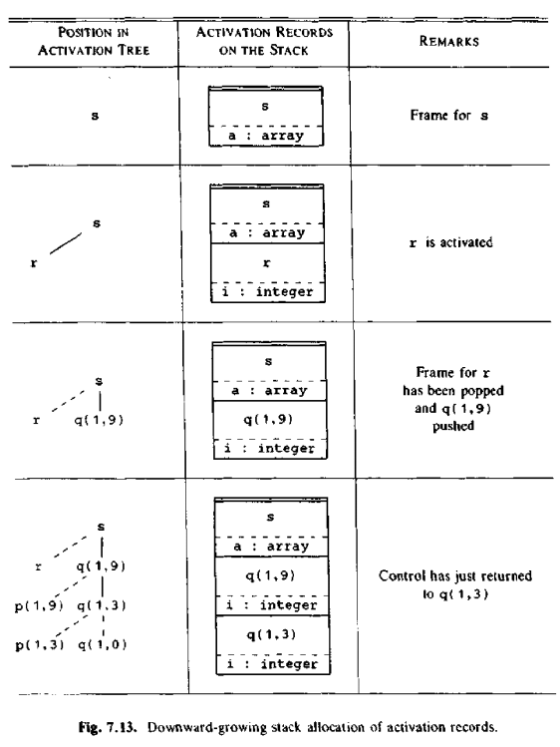

Slide 19
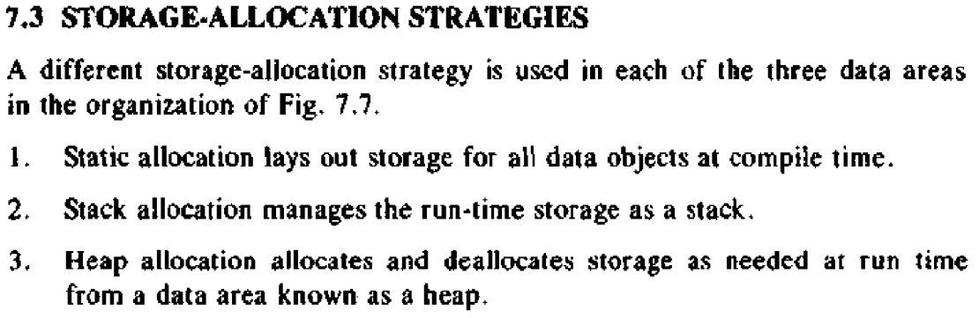

Slide 20
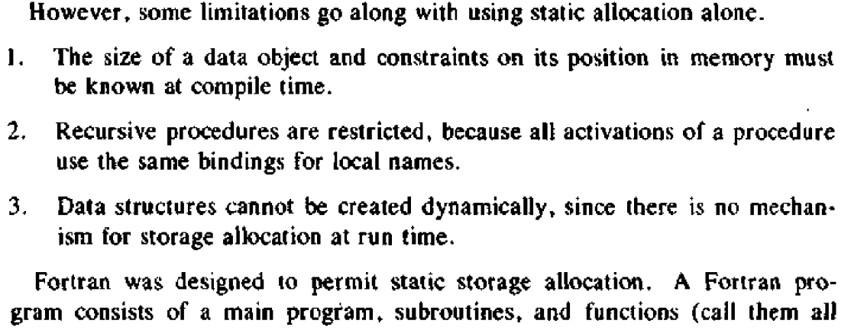

Slide 21
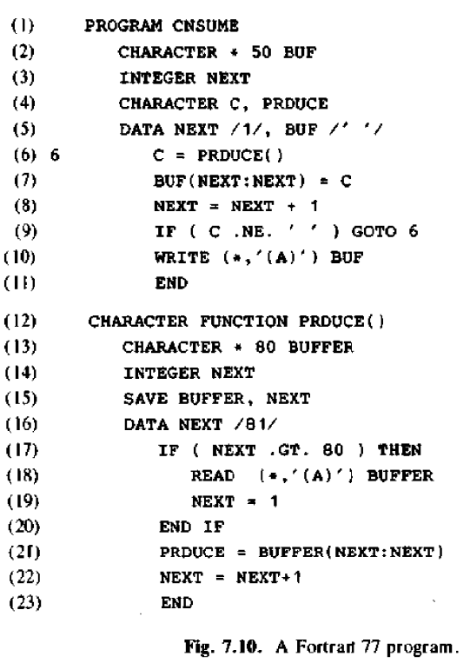

Slide 22
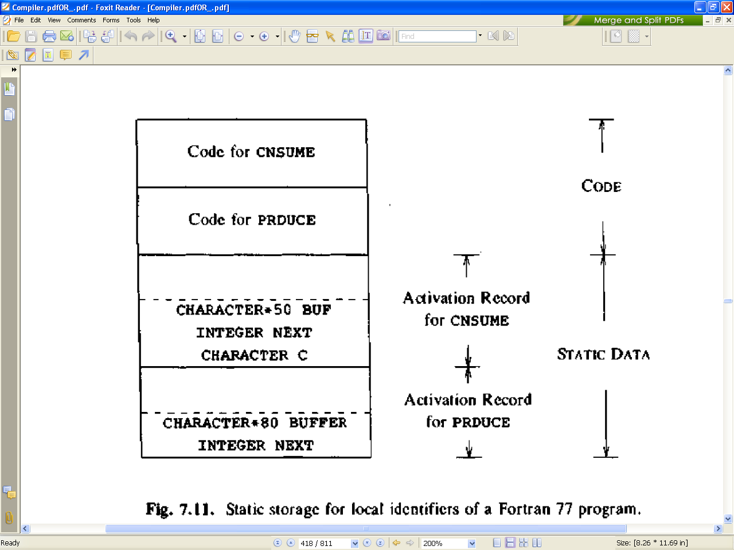

Slide 23
Stack Allocation
Activation records (subroutine frames) on the run-time stack hold the state of a subroutine
Calling sequences are code statements to create activations records on the stack and enter data in them
  Caller’s calling sequence enters actual arguments, control link, access link, and saved machine state
  Callee’s calling sequence initializes local data
  Callee’s return sequence enters return value
  Caller’s return sequence removes activation record

Slide 24
Activation records
Procedure calls and returns are usaully managed by a run-time stack called the control stack.
Each live activation has an activation record (sometimes called a frame)
The root of activation tree is at the bottom of the stack
The current execution path specifies the content of the stack with the last activation has record in the top of the stack.

Slide 25
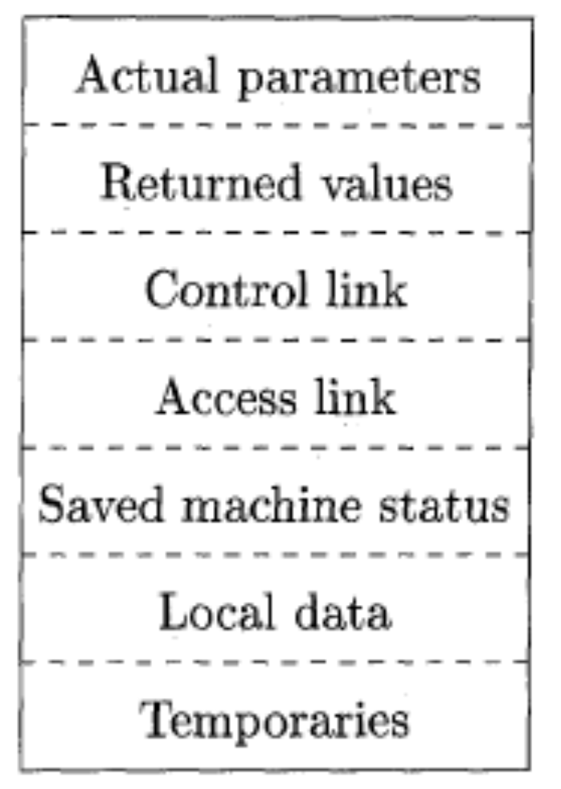
A General Activation Record

Slide 26
Activation Record
Temporary values
Local data
A saved machine status
An “access link”
A control link
Space for the return value of the called function
The actual parameters used by the calling procedure

Slide 27
Activation Records
(Subroutine Frames)
fp
(frame pointer)
Returned value
Actual parameters
Optional control link
Optional access link
Saved machine status (w/ opt. return address)
Local data
Temporaries
Caller’s
responsibility
to initialize
Callee’s
responsibility
to initialize

Slide 28
Control Links
The control link is the old value of the fp
Caller’s activation record
fp
Callee’s activation record
Control link
sp
Stack
growth

Slide 29
Scope with Nested Procedures
program sort(input, output)
var a : array [0..10] of integer;
x : integer;
procedure readarray;
var i : integer;
begin … end;
procedure exchange(i, j : integer);
begin x := a[i]; a[i] := a[j]; a[j] := x end;
procedure quicksort(m, n : integer);
var k, v : integer;
function partition(y, z : integer) : integer
var i, j : integer;
begin … exchange(i, j) … end
begin
if (n > m) then begin
i := partition(m, n);
quicksort(m, i - 1);
quicksort(i + 1, n)
end
end;
begin
…
quicksort(1, 9)
end.

Slide 30
Access Links (Static Links)
s a x
q(1,9) access k v
s a x
q(1,9) access k v
q(1,3) access k v
s a x
q(1,9) access k v
q(1,3) access k v
p(1,3) access i j
s a x
q(1,9) access k v
q(1,3) access k v
p(1,3) access i j
e(1,3) access
The access link points to the activation record of the static parent procedure:
s is parent of r, e, and q
q is parent of p

Slide 31
Accessing Nonlocal Data
To implement access to nonlocal data a in procedure p, the compiler generates code to traverse n_{p} - n_{a} access links to reach the activation record where a resides
  n_{p} is the nesting depth of procedure p
  n_{a} is the nesting depth of the procedure containing a

Slide 32
Parameter Passing Modes
Call-by-value: evaluate actual parameters and enter r-values in activation record
Call-by-reference: enter pointer to the storage of the actual parameter
Copy-restore (aka value-result): evaluate actual parameters and enter r-values, after the call copy r-values of formal parameters into actuals
Call-by-name: use a form of in-line code expansion (thunk) to evaluate parameters

Slide 33
Designing Calling Sequences
Values communicated between caller and callee are generally placed at the beginning of callee’s activation record
Fixed-length items: are generally placed at the middle
Items whose size may not be known early enough: are placed at the end of activation record
We must locate the top-of-stack pointer judiciously: a common approach is to have it point to the end of fixed length fields.

Slide 34
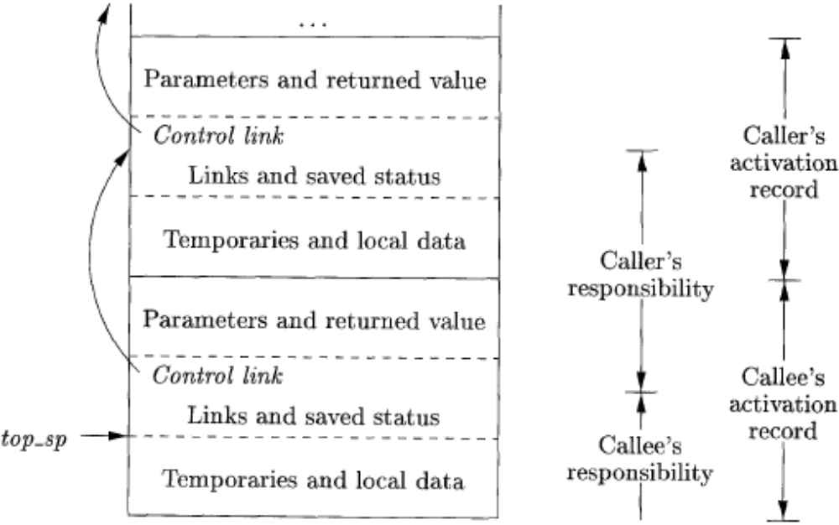
Division of tasks between caller and callee

Slide 35
calling sequence
The caller evaluates the actual parameters
The caller stores a return address and the old value of top-sp into the callee's activation record.
The callee saves the register values and other status information.
The callee initializes its local data and begins execution.

Slide 36
corresponding return sequence
The callee places the return value next to the parameters
Using information in the machine-status field, the callee restores top-sp and other registers, and then branches to the return address that the caller placed in the status field.
Although top-sp has been decremented, the caller knows where the return value is, relative to the current value of top-sp; the caller therefore may use that value.

Slide 37
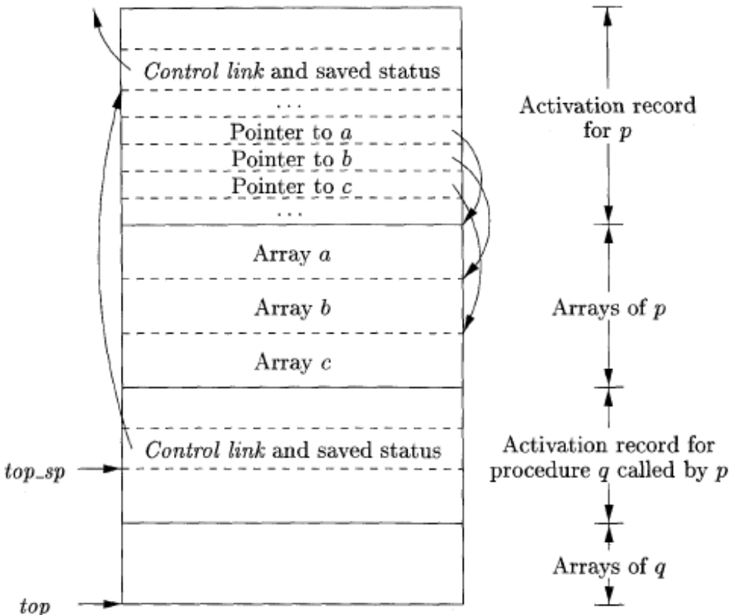
Access to dynamically allocated arrays (variable length data)

Slide 38
Access to Nonlocal data on the Disk
Data Access Without Nested Procedures
Issues With Nested Procedures
A Language With Nested Procedure Declarations
Nesting Depth
Access Links
Manipulating Access Links
Access Links for Procedure Parameters
Displays

Slide 39
How procedures access their data.
Especially important is the mechanism for finding data used within a procedure p but that does not belong to p.
Access becomes more complicated in languages where procedures can be declared inside other procedures.

Slide 40
Data Access Without Nested Procedures
In the C family of languages, all variables are defined either within a single function or outside any function ("globally").
It is impossible to declare one procedure whose scope is entirely within another procedure.
Rather, a global variable v has a scope consisting of all the functions that follow the declaration of v, except where there is a local definition of the identifier v. Variables declared within a function have a scope consisting of that function only, or part of it, if the function has nested blocks.

Slide 41
For languages that do not allow nested procedure declarations, allocation of storage for variables and access to those variables is simple:
1. Global variables are allocated static storage.
The locations of these variables remain fixed and are known at compile time.
So to access any variable that is not local to the currently executing procedure, we simply use the statically determined address.
2. Any other name must be local to the activation at the top of the stack.

Slide 42
An important benefit of static allocation for globals is that declared procedures may be passed as parameters or returned as results (in C, a pointer to the function is passed), with no substantial change in the data-access strategy.
With the C static-scoping rule, and without nested procedures, any name non-local to one procedure is nonlocal to all procedures, regardless of how they are activated.
Similarly, if a procedure is returned as a result, then any nonlocal name refers to the storage statically allocated for it.

Slide 43
Issues with nested Procedures
Access becomes far more complicated when a language allows procedure declarations to be nested and also uses the normal static scoping rule;
A procedure can access variables of the procedures whose declarations surround its own declaration, following the nested scoping rule.
The reason is that knowing at compile time that the declaration of p is immediately nested within q does not tell us the relative positions of their activation records at run time.
In fact, since either p or q or both may be recursive, there may be several activation records of p and/or q on the stack.

Slide 44
Finding the declaration that applies to a nonlocal name x in a nested procedure p is a static decision;
it can be done by an extension of the static-scope rule for blocks.
Suppose x is declared in the enclosing procedure q. Finding the relevant activation of q from an activation of p is a dynamic decision;
it requires additional run-time information about activations.
One possible solution to this problem is to use "access links"

Slide 45
A Language with Nested Procedure Declarations
The C family of languages, and many other familiar languages do not support nested procedures
The history of nested procedures in languages is long.
Algol 60, an ancestor of C, had this capability, as did its descendant Pascal, a once-popular teaching language.
Of the later languages with nested procedures, one of the most influential is ML, and it is this language whose syntax and semantics is used in next example.

Slide 46
ML is a functional language, meaning that variables,
once declared and initialized, are not changed.
There are only a few exceptions, such as the array, whose elements can be changed by special function calls.
Variables are defined, and have their unchangeable values initialized, by a statement of the form:
val (name) = (expression)
Functions are defined using the syntax:
fun (name) ( (arguments) ) = (body)
•
•

Slide 47
For function bodies we shall use let-statements of the form:
Let (list of definitions) in (statements) end
The definitions are normally val or fun statements.
The scope of each such definition consists of all following definitions, up to the in, and all the statements up to the end.
Most importantly, function definitions can be nested.
For example, the body of a function p can contain a let-statement that includes the definition of another (nested) function q.
Similarly, q can have function definitions within its own body, leading to arbitrarily deep nesting of function

Slide 48
Nesting Depth
Let us give nesting depth 1 to procedures that are not nested within any other procedure.
For example, all C functions are at nesting depth 1.
If a procedure p is defined immediately within a procedure at nesting depth i, then give p the nesting depth i +1
The only function at nesting depth 1 is the outermost function, sort, which reads an array a of 9 integers.
All ML arrays are indexed by integers starting with 0
This array is quite similar to the C array a.
The second argument of a r r a y says that initially, all elements of the array a hold the value 0. This choice of initial value lets the ML compiler deduce that a is an integer array, since 0 is an integer, so we never have to declare a type for a.

Slide 49
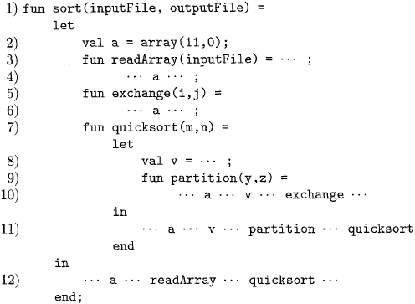
A version of quicksort, in ML style, using nested functions

Slide 50
In sort, 3 functions are there :
readArray, exchange, and quicksort.
Since each of these three functions are defined immediately within a function at nesting depth 1, their nesting depths are all 2.
Function partition is defined at line (9).
Partition accesses both the array a and the pivot value v, and also calls the function exchange.
Since partition is defined immediately within a function at nesting depth 2, it is at depth 3.

Slide 51
Access Links
A normal static scope rule for nested functions is obtained by adding a pointer called the access link to each activation record.
If procedure p is nested immediately within procedure q in the source code, then the access link in any activation of p points to the most recent activation of q.
The nesting depth of q must be exactly one less than the nesting depth of p.
Access links form a chain from the activation record at the top of the stack to a sequence of activations at progressively lower nesting depths.
Along this chain are all the activations whose data and procedures are accessible to the currently executing procedure.

Slide 52
If the procedure p at the top of the stack is at nesting depth n_{p}, and p needs to access x, which is an element defined within some procedure q that surrounds p and has nesting depth nq.
nq =< np, with equality only if p and q are the same procedure.
To find x, we start at the activation record for p at the top of the stack and follow the access link np — nq times, from activation record to activation record.
we wind up at an activation record for q, and it will always be the most recent (highest) activation record for q that currently appears on the stack that contains the element x .
As the compiler knows the layout of activation records, x will be found at some fixed offset from the position in q's activation record that we can reach by following the last access link.

Slide 53
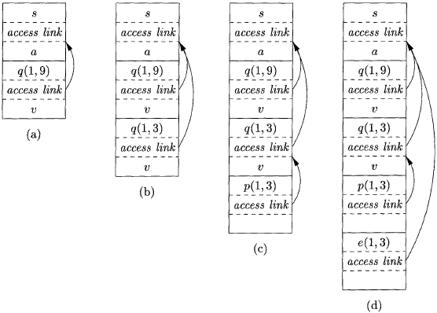
Access links for finding nonlocal data

Slide 54
Manipulating Access Links
How are access links determined?
When a procedure call occurs to a particular procedure whose name is given explicitly in the procedure call.
The harder case is when the call is to a procedure parameter
The particular procedure being called is not known until run time, and the nesting depth of the called procedure may differ in different executions of the call.
Thus, let us first consider what should happen when a procedure q calls procedure p, explicitly.

Slide 55
There are three cases:
Procedure p is at a higher nesting depth than q.
  Then p must be defined immediately within q, or the call by q would not be at a position that is within the scope of the procedure name p.
  Thus, the nesting depth of p is exactly one greater than that of q, and the access link from p must lead to q.
  The calling sequence includes a step that places in the access link for p a pointer to the activation record of q.
  Examples include the call of quicksort by sort to set up Fig. 7.11(a), and the call of partition by quicksort to create Fig. 7.11(c).

Slide 56
2. The call is recursive, that is, p = q
Then the access link for the new activation record is the same as that of the activation record below it.
An example is the call of quicksort(l, 3) by quicksort(l, 9) to set up Fig. 7.11(b).
3. The nesting depth np of p is less than the nesting depth nq of q.
In order for the call within q to be in the scope of name p, procedure q must be nested within some procedure r, while p is a procedure defined immediately within r. The top activation record for r can therefore be found by following the chain of access links, starting in the activation record for q, for nq — np + 1 hops. Then, the access link for p must go to this activation of r.

Slide 57
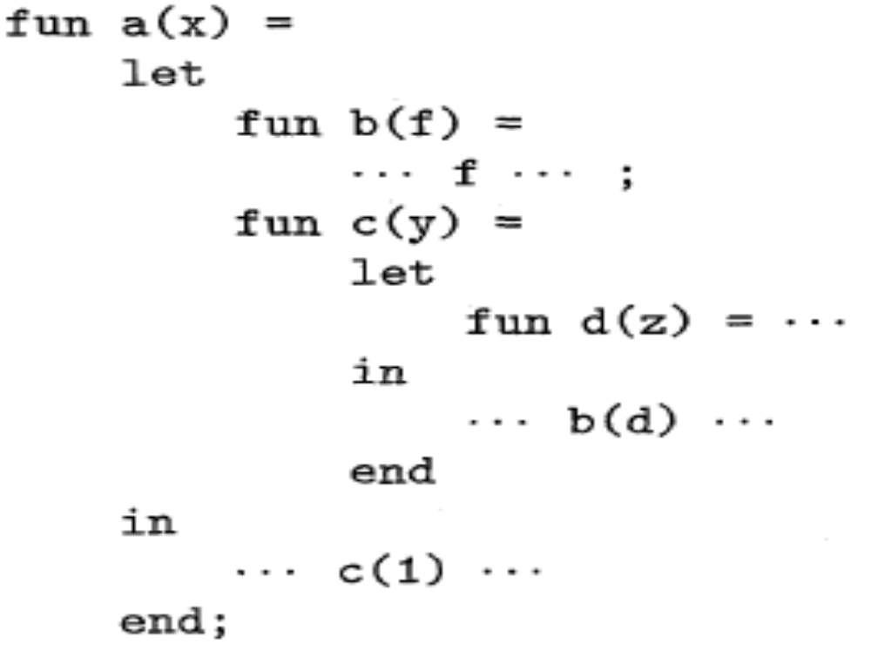
7.3.7. Access Links for Procedure Parameters
Sketch of ML program that uses function-parameters

Slide 58
When a procedure p is passed to another procedure q as a parameter
q then calls its parameter (and therefore calls p in this activation of q)
It is possible that q does not know the context in which p appears in the program.
If so, it is impossible for q to know how to set the access link for p.
The solution to this problem is as follows: when procedures are used as parameters, the caller needs to pass, along with the name of the procedure-parameter, the proper access link for that parameter.

Slide 59
The caller always knows the link, since if p is passed by procedure r as an actual parameter, then p must be a name accessible to r, and therefore, r can determine the access link for p exactly as if p were being called by r directly.
we use the rules defined for Manipulating Access Links for constructing access links
Function a that has functions b and c nested within it.
Fun b has a function-valued parameter f, which it calls.
Function c defines within it a function d, and c then calls b with actual parameter d.

Slide 60
When a is executed. First, a calls c,
so we place an activation record for c above that for a on the stack.
The access link for c points to the record for a, since c is defined immediately within a.
Then c calls b(d).
The calling sequence sets up an activation record for b within this activation record is the actual parameter d and its access link, which together form the value of formal parameter f in the activation record for b.
c knows about d, since d is defined within c, and therefore c passes a pointer to its own activation record as the access link.

Slide 61
No matter where d was defined, if c is in the scope of that definition, then one of the three rules of Section 7.3.6 must apply, and c can provide the link.
Now, let us look at what b does. We know that at some point, it uses its parameter f, which has the effect of calling d.
An activation record for d appears on the stack, as shown in Fig. 7.13(b).
The proper access link to place in this activation record is found in the value for parameter f;
The link is to the activation record for c, since c immediately surrounds the definition of d.
Notice that b is capable of setting up the proper link, even though b is not in the scope of c's definition. •

Slide 62
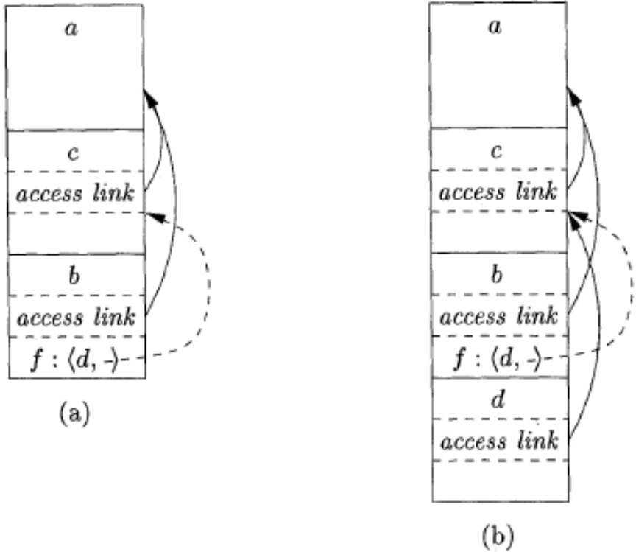
Actual parameters carry their access link with them

Slide 63
7.3.8 Displays
One problem with the access-link approach to nonlocal data is that if the nesting depth gets large, we may have to follow long chains of links to reach the data we need.
A more efficient implementation uses an auxiliary array d, called the display, which consists of one pointer for each nesting depth.
We arrange that, at all times, d[i] is a pointer to the highest activation record on the stack for any procedure at nesting depth i.

Slide 64
For instance, in Fig. 7.14(d), we see the display d, with d[l] holding a pointer to the activation record for sort , the highest (and only) activation record for a function at nesting depth 1.
d[2] holds a pointer to the activation record for exchange, the highest record at depth 2
d[3] points to partition, the highest record at depth 3.
The advantage of using a display is that if procedure p
is executing, and it needs to access element x belonging to some procedure q,
we need to look only in d[i], where i is the nesting depth of q; we follow the pointer d[i] to the activation record for q, wherein x is found at a known offset.

Slide 65
The compiler knows what “i “ is, so it can generate code to access x using d[i] and the offset of x from the top of the activation record for q.
In order to maintain the display correctly, we need to save previous values of display entries in new activation records.
If procedure p at depth n_{p} is called, and its activation record is not the first on the stack for a procedure at depth n_{p}, then the activation record for p needs to hold the previous value of d[n_{p}], while d[n_{p}]itself is set to point to this activation of p.
When p returns, and its activation record is removed from the stack, we restore d[n_{p}] to have its value prior to the call of p.

Slide 66
Several steps of manipulating the display are illustrated in Fig.
In Fig. (a), sort at depth 1 has called quicksort(l, 9) at depth 2.
The activation record for quicksort has a place to store the old value of d[2], indicated as saved d[2],although in this case since there was no prior activation record at depth 2, this pointer is null.
In Fig. (b), quicksort(l, 9) calls quicksort(l, 3). Since the activation records for both calls are at depth 2, we must store the pointer to quicksort(l, 9), which was in d[2], in the record for quicksort(l, 3). Then, d[2] is made to point to quicksort(l, 3).

Slide 67
Next, partition is called.
This function is at depth 3, so we use the slot d[3] in the display for the first time, and make it point to the activation record for partition.
The record for partition has a slot for a former value of d[3], but in this case there is none, so the pointer remains null.
The display and stack at this time are shown in Fig. 7.14(c).
Then, partition calls exchange.
That function is at depth 2, so its activation record stores the old pointer d[2], which goes to the activation record for quicksort(l, 3).
The display pointers "cross"; that is, d[3] points further down the stack than d[2] does.
exchange can only access its own data and that of sort, via d[l].

Slide 68
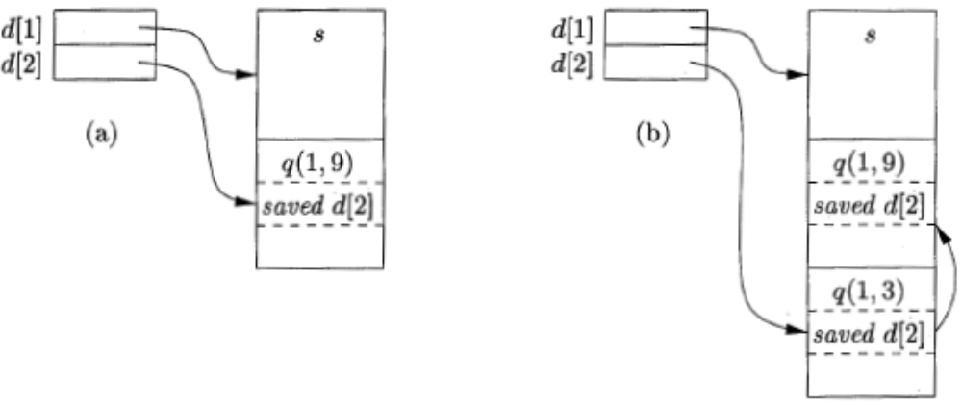
Maintaining the Display

Slide 69
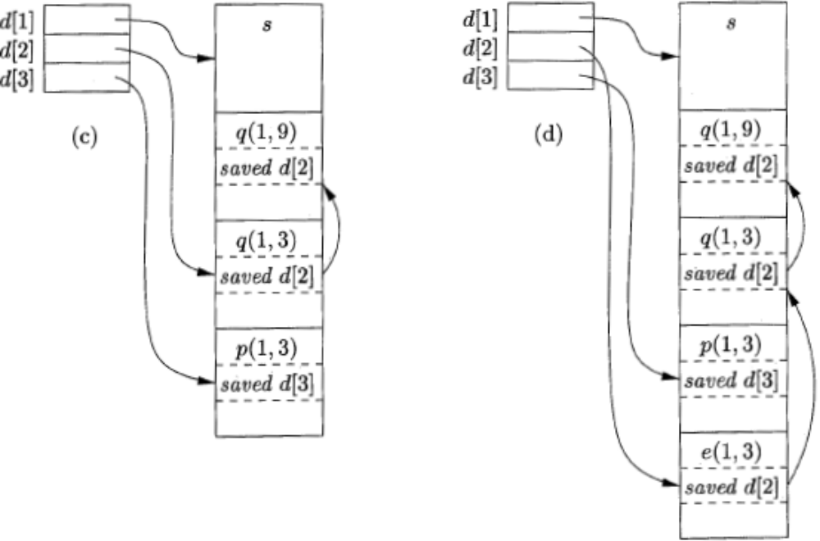
Maintaining the Display (Cont.)

Slide 70
Heap Management
1 The Memory Manager
2 The Memory Hierarchy of a Computer
3 Locality in Programs
4 Reducing Fragmentation
5 Manual Deallocation Requests

Slide 71
The heap is the portion of the store that is used for data that lives indefinitely, or until the program explicitly deletes it.
While local variables typically become inaccessible when their procedures end
Many languages enable us to create objects or other data whose existence is not tied to the procedure activation that creates them.
C + + and Java give the programmer new to create objects that may be passed — or pointers to them may be passed — from procedure to procedure, so they continue to exist long after the procedure that created them is gone. Such objects are stored on a heap.

Slide 72
Memory Manager
It serves as an interface between application programs and the operating system.
Two basic functions:
  Allocation
  Deallocation
Properties of memory managers:
  Space efficiency
  Program efficiency
  Low overhead

Slide 73
The Memory Hierarchy of a Computer
The efficiency of a program is determined not just by the number of instructions executed, but also by how long it takes to execute each of these instructions.
The time taken to execute an instruction can vary significantly, since the time taken to access different parts of memory can vary from nanoseconds to milliseconds.
Data-intensive programs can therefore benefit significantly from optimizations that make good use of the memory subsystem.

Slide 74
The large variance in memory access times is due to the fundamental limitation in hardware technology;
we can build small and fast storage, or large and slow storage.
It is simply impossible today to build gigabytes of storage with nanosecond access times, which is how fast high-performance processors run.
Practically all modern computers arrange their storage as a memory hierarchy.
A memory hierarchy consists of a series of storage elements, with the smaller faster ones "closer" to the processor, and the larger slower ones further away.

Slide 75
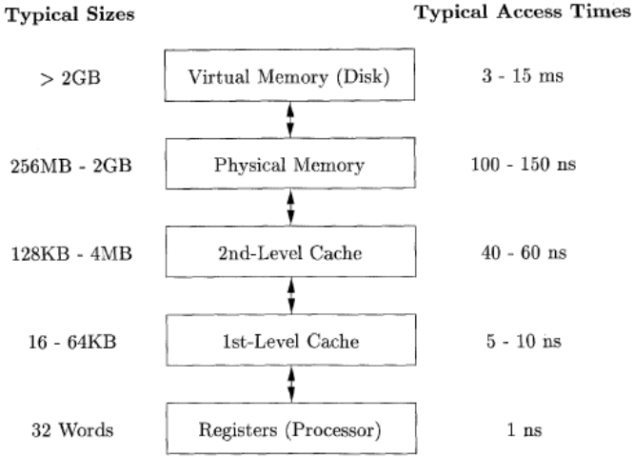
Typical Memory Hierarchy Configurations

Slide 76
Locality in Programs
The conventional wisdom is that programs spend 90% of their time executing 10% of the code:
Programs often contain many instructions that are never executed.
Only a small fraction of the code that could be invoked is actually executed in a typical run of the program.
The typical program spends most of its time executing innermost loops and tight recursive cycles in a program.

Slide 77
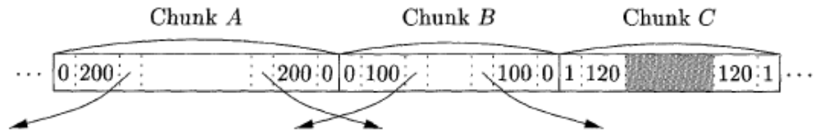
Part of a Heap

